Slide 1
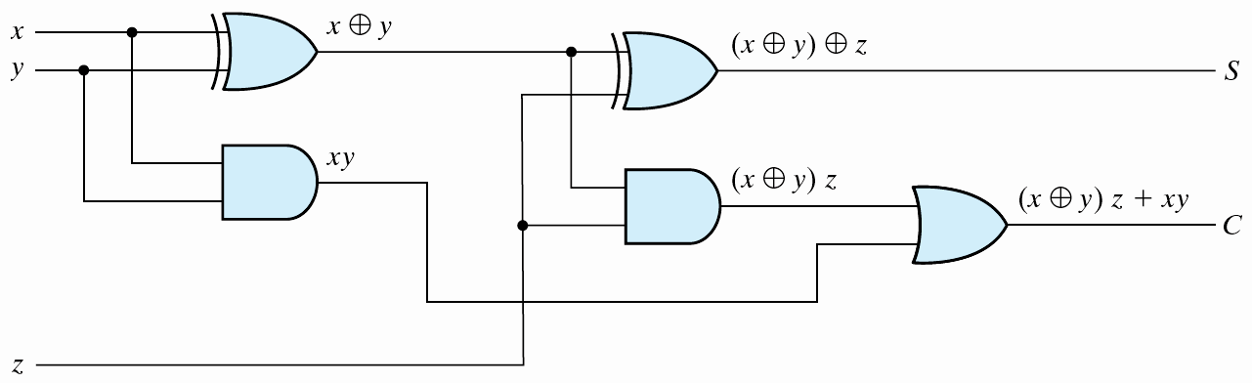
Combinational Circuits
Boolean functions
Truth table

Slide 2
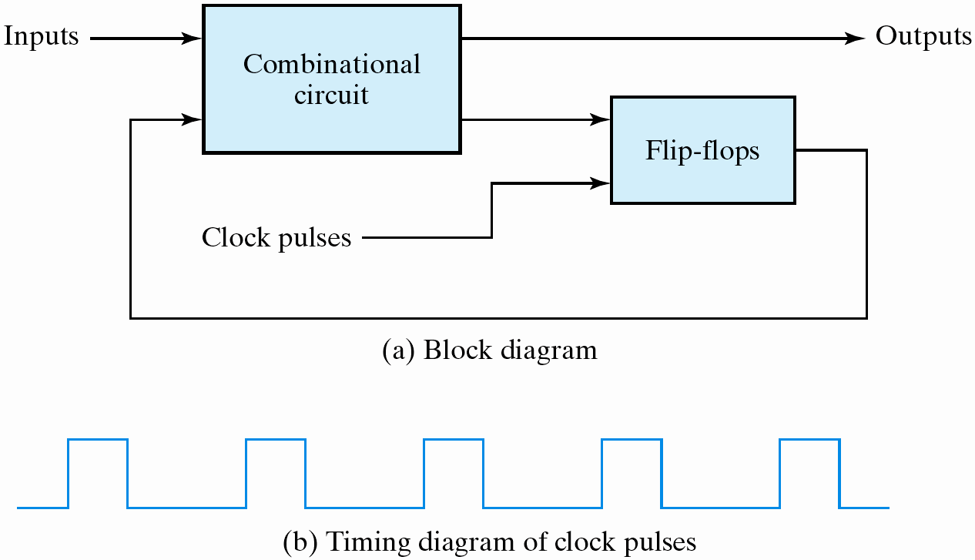
Sequential Circuits

Slide 3
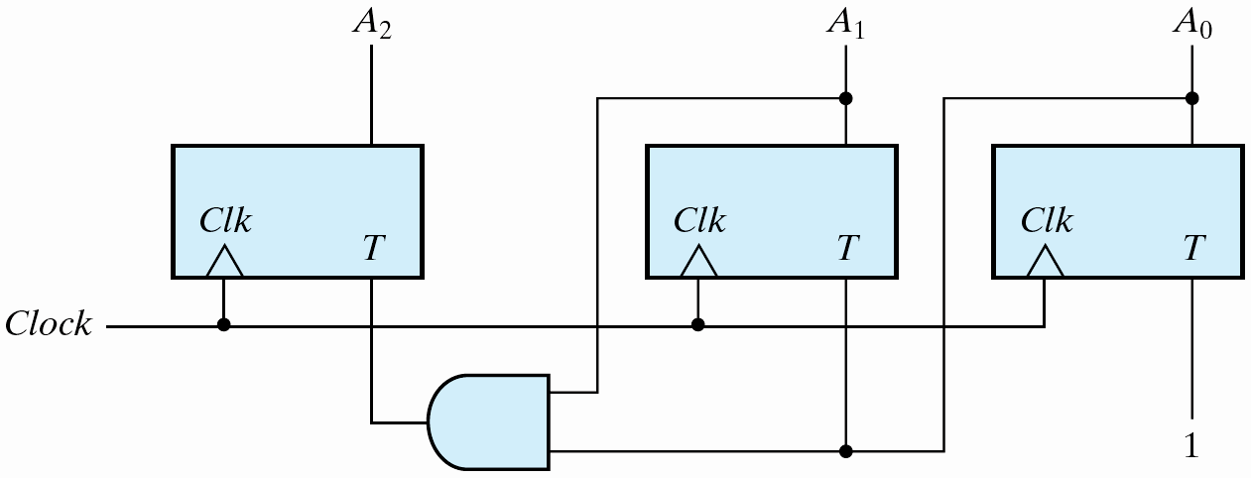
Logic simplification using the K map
  T_{A2} = A₀A₁
  T_{A1} = A₀
  T_{A0} = 1
The state diagram

Slide 4
Combinational Circuits: Mux
reg out ;
always@(a or b or sel)
  out=(sel==0)?a:b ;
always@(a, b, sel)
  out=(sel==0)?a:b ;
always@(*)
  out=(sel==0)?a:b ;
always@(*)
  if (!sel)
  out = a ;
  else
  out = b ;

Slide 5
Sequential Always Blocks
Inferred latches (Incomplete branch specifications)
  module infer_latch(D, enable, Q);
  input D, enable;
  output Q;
  reg Q;
  always @ (D or enable) begin
  if (enable)
  Q <= D;
  end
  endmodule
  the Q is not specified in a branch
    a latch like 74373

Slide 6
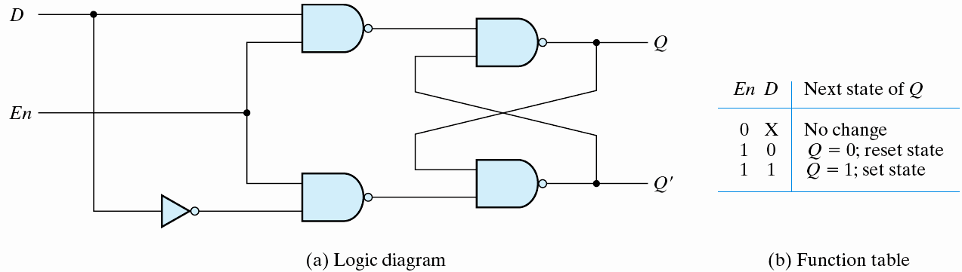
D Latch
  Eliminate the undesirable conditions of the indeterminate state in the RS flip-flop
  D: data
  gated D-latch
  D ⇒ Q when C=1; no change when C=0
S_
1/D'
0/1
R_
1/D

Slide 7
Multiplexor
4-to-1 multiplexor
  module mux4_1 (out, in0, in1, in2, in3, sel) ;
  output out ;
  input in0,in1,in2,in3 ;
  input [1:0] sel ;
  assign out = (sel == 2'b00) ? in0 :
  (sel == 2'b01) ? in1 :
  (sel == 2'b10) ? in2 :
  (sel == 2'b11) ? in3 :
  1'bx ;
  endmodule

Slide 8
  module mux4_1 (out, in, sel) ;
  output out ;
  input [3:0] in ;
  input [1:0] sel ;
  reg out ;
  always @(sel or in) begin
  case(sel)
  2'd0: out = in[0] ;
  2'd1: out = in[1] ;
  2'd2: out = in[2] ;
  2'd3: out = in[3] ;
  default: 1'bx ;
  endcase
  end
  endmodule
out = in[sel] ;

Slide 9
Decoder
3-to 8 decoder with an enable control
  module decoder(o,enb_,sel) ;
  output [7:0] o ;
  input enb_ ;
  input [2:0] sel ;
  reg [7:0] o ;
  always @ (enb_ or sel)
  if(enb_)
    o = 8'b1111_1111 ;
  else
  case(sel)
  3'b000 : o = 8'b1111_1110 ;
  3'b001 : o = 8'b1111_1101 ;
  3'b010 : o = 8'b1111_1011 ;
  3'b011 : o = 8'b1111_0111 ;
  3'b100 : o = 8'b1110_1111 ;
  3'b101 : o = 8'b1101_1111 ;
  3'b110 : o = 8'b1011_1111 ;
  3'b111 : o = 8'b0111_1111 ;
  default : o = 8'bx ;
  endcase
  endmodule

Slide 10
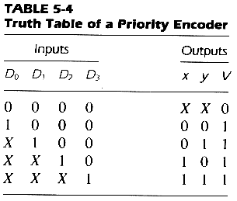
Priority Encoder
  always @ (d0 or d1 or d2 or d3)
    if (d3 == 1)
      {x,y,v} = 3’b111 ;
    else if (d2 == 1)
      {x,y,v} = 3’b101 ;
    else if (d1 == 1)
      {x,y,v} = 3’b011 ;
    else if (d0 == 1)
      {x,y,v} = 3’b001 ;
    else
      {x,y,v} = 3’bxx0 ;

Slide 11
Parity Checker
module parity_chk(data, parity);
input [0:7] data;
output parity;
reg parity;
always @ (data)
begin: check_parity
reg partial;
integer n;
partial = data[0];
for ( n = 0; n <= 7; n = n + 1)
begin
partial = partial ^ data[n];
end
parity <= partial;
end
endmodule

Slide 12
Adder
RTL modeling
  module adder(c,s,a,b) ;
  output c ;
  output [7:0] s ;
  input [7:0] a,b ;
  assign {c,s} = a + b ;
  endmodule
Logic synthesis
  CLA adder for speed optimization
  ripple adder for area optimization

Slide 13
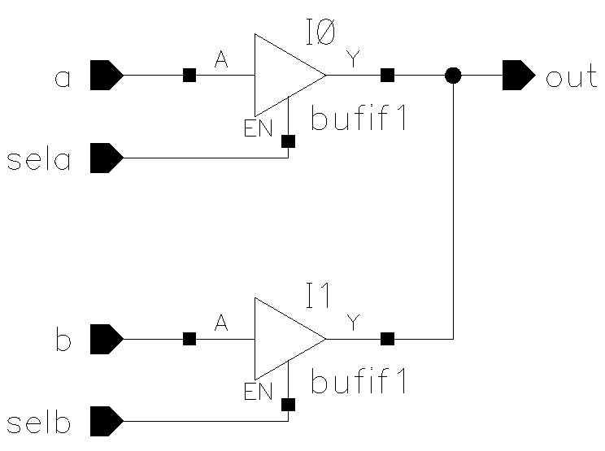
Tri-State
The value z
  always @ (sela or a)
    if (sela)
        out = a ;
    else
        out = 1’bz ;
Another block
  always @(selb or b)
    if(selb)
        out =b ;
    else
        out = 1’bz ;
assign out = (sela)? a: 1’bz ;

Slide 14
Registers (Flip-flops) are implied
  @(posedge clk) or @(negedge clk)
  a positive edge-triggered D flip-flop
  always @ (posedge clk)
  q = d ;

Slide 15
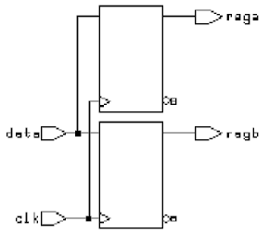
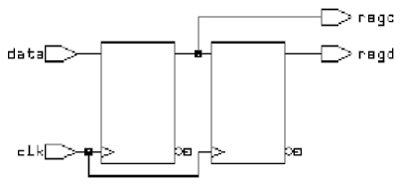
Procedural Assignments
Blocking assignments
  always @(posedge clk) begin
    rega = data ;
    regb = rega ;
  end
Non-blocking assignments
  always @(posedge clk) begin
    regc <= data ;
    regd <= regc ;
  end

Slide 16
Sequential Circuit Design
Inputs
Combinational
circuit
Outputs
Memory
elements
  a feedback path
  the state of the sequential circuits
  the state transition
    synchronous circuits
    asynchronous circuits

Slide 17
Examples
  D flip-flop
  D latch
  register
  shifter
  counter
  pipeline
  FSM

Slide 18
Flip-Flop
Synchronous clear
  module d_ff (q,d,clk,clr_) ;
  output q ;
  input d,clk,clr_ ;
  reg q ;
  always @ (posedge clk)
  if (~clr_) q = 0 ;
  else q = d ;
  endmodule
Asynchronous clear
  always @ (posedge clk or negedge clr_)
  if (~clr_) q = 0 ;
  else q = d ;

Slide 19
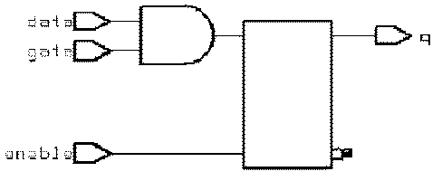
D Latches
D latch
  always @ (enable or data)
  if (enable)
  q = data ;
D latch with gated asynchronous data
  always @ (enable or data or gate)
  if (enable)
  q = data & gate ;

Slide 20
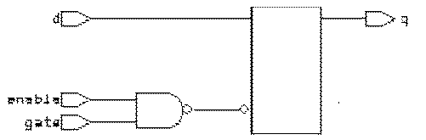
D latch with gated ‘enable’
  always @ (enable or d or gate)
  if (enable & gate)
  q = d ;
D latch with asynchronous reset
  always @ (reset or data or gate)
  if (reset)
  q = 1’b0
  else if(enable)
  q = data ;

Slide 21
Finite State Machine
Moore model
Mealy model
inputs
next
state
current
state
comb.
circuit
memory
elements
comb.
circuit
outputs
inputs
next
state
current
state
comb.
circuit
memory
elements
comb.
circuit
outputs

Slide 22
Inefficient Description
  module count (clock, reset, and_bits, or_bits, xor_bits);
  input clock, reset;
  output and_bits, or_bits, xor_bits;
  reg and_bits, or_bits, xor_bits;
  reg [2:0] count;
  always @(posedge clock) begin
  if (reset)
  count = 0;
  else
  count = count + 1;
  and_bits = & count;
  or_bits = | count;
  xor_bits = ^ count;
  end
  endmodule

Slide 23
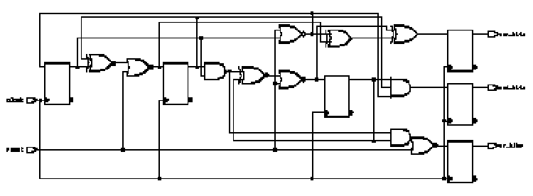
Six implied registers

Slide 24
Efficient Description
Separate combinational and sequential circuits
module count (clock, reset, and_bits, or_bits, xor_bits);
input clock, reset;
output and_bits, or_bits, xor_bits;
reg and_bits, or_bits, xor_bits;
reg [2:0] count;
always @(posedge clock) begin
if (reset)
count = 0;
else
count = count + 1;
end
// combinational circuits
always @(count) begin
and_bits = & count;
or_bits = | count;
xor_bits = ^ count;
end
endmodule

Slide 25
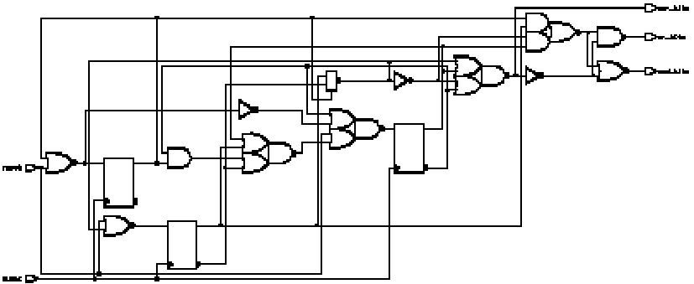
Three registers are used

Slide 26
Mealy Machine Example
module mealy (in1, in2, clk, reset,out);
input in1, in2, clk, reset;
output out;
reg current_state, next_state, out;
// state flip-flops
always @(posedge clk or negedge reset)
if (!reset)
current_state = 0;
else
current_state = next_state;
// combinational: next-state and outputs
always @(in1 or in2 or current_state)
case (current_state)
0: begin
next_state = 1;
out = 1'b0;
end
1: if (in1) begin
next_state = 1'b0;
out = in2;
end
else begin
next_state = 1'b1;
out = !in2;
end
endcase
endmodule

Slide 27
Moore Machine
Sequence recognizer
Present
Next State
Output
0
1
State
x=0 x=1
y
1
1
0
A/0
B/0
C/0
D/0
A
A
B
0
B
A
C
0
0
1
1
C
D
C
0
0
E/1
D
A
E
0
E
A
C
1
0
inputs
next
state
current
state
comb.
circuit
memory
elements
comb.
circuit
outputs

Slide 28
Seq_Rcgn.v
`timescale 1ns/10ps
module SeqRcgn (out, x, clk, reset_) ;
// Port declarations
output out ;
input x, clk, reset_ ;
reg out ;
reg[2:0] state, next_state ;
parameter A= 3'b000, B=3'b001, C=3'b011, D=3'b010, E=3'b110;
always@ (posedge clk or negedge reset_)
if(!reset_) // an asynchronous reset_
state = A ;
else
state = next_state ;

Slide 29
always@ (state or x)
case(state) // state transition
A:
if(x)
next_state = B ;
else
next_state = A ;
B:
if(x)
next_state = C ;
else
next_state = A ;
Present
Next State
Output
State
x=0 x=1
y
A
A
B
0
B
A
C
0
C
D
C
0
D
A
E
0
E
A
C
1

Slide 30
C:
if(x)
next_state = C ;
else
next_state = D ;
D:
if(x)
next_state = E ;
else
next_state = A ;
Present
Next State
Output
State
x=0 x=1
y
A
A
B
0
B
A
C
0
C
D
C
0
D
A
E
0
E
A
C
1

Slide 31
E:
if(x)
next_state = C ;
else
next_state = A ;
default:
next_state = 3'bxxx ;
endcase
Present
Next State
Output
State
x=0 x=1
y
A
A
B
0
B
A
C
0
C
D
C
0
D
A
E
0
E
A
C
1

Slide 32
always@ (state)
case (state)
A, B, C, D:
out = 0 ;
E:
out = 1 ;
default:
out = 1'bx ;
endcase
endmodule
Present
Next State
Output
State
x=0 x=1
y
A
A
B
0
B
A
C
0
C
D
C
0
D
A
E
0
E
A
C
1

Slide 33
Test Fixture
module test_SeqRcng ;
reg x, clk, reset_ ;
//SeqRcgn instance
SeqRcgn SR1 (out, x, clk, reset_) ;
//Stimulus
initial
begin
clk = 1'b0 ;
repeat(30)
#10 clk = ~clk ;
end

Slide 34
initial
begin
x = 0 ; reset_ = 0;
#15 reset_ = 1; x = 1 ;
#20 x = 0 ;
#20 x = 1 ;
#20 x = 0 ;
#20 x = 1 ;
#20 x = 1 ;
#20 x = 1 ;
#20 x = 0 ;
#20 x = 1 ;
#20 x = 1 ;
#20 x = 0 ;
#20 x = 1 ;
#20 x = 1 ;
#20 x = 1 ;
#20 x = 0 ;
#20 x = 1 ;
end

Slide 35
initial
begin
$display(" time out x clk reset_"); $monitor($time, " %b %b %b %b", out, x, clk, reset_);
end
initial
begin
$dumpfile("SeqRcgn.vcd");
$dumpvars;
end
endmodule

Slide 36
Download SeqRcgn.v
iverilog -o SeqRcgn.vvp SeqRcgn.v
vvp SeqRcgn.vvp
gtkwave SeqRcgn.vcd

Slide 37
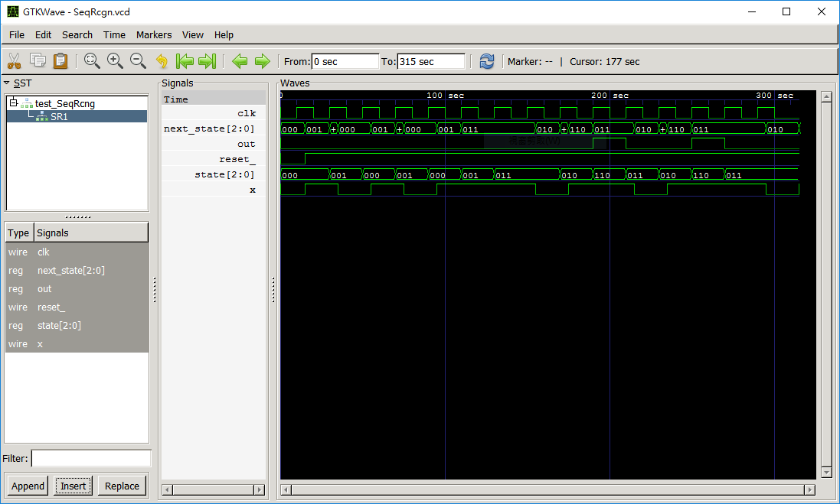

gtkwave

Slide 39
Verilog MP2
A sequence recognizer
  input i, clk, reset_ (active-low async. reset)
  output o
Asserts o when it has observed the BCD of the last digit of your student ID
Use a Moore model FSM
Explain the state transitions and outputs of your simulation

Slide 40
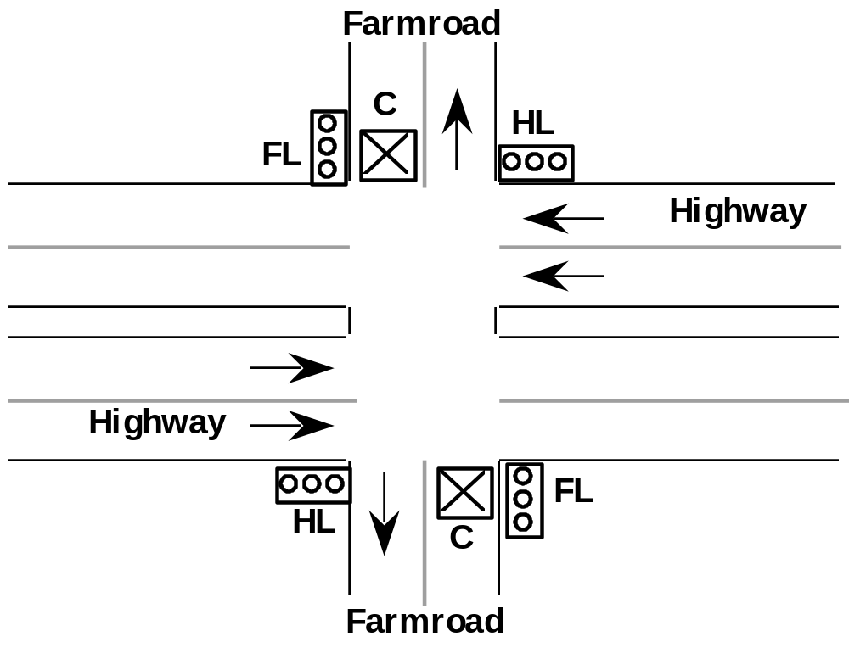
A FSM Example
Traffic Light Controller
Picture of Highway/Farmroad Intersection:

Slide 41
Specifications
Traffic Light Controller
? Tabulation of Inputs and Outputs:
Input Signal
reset
C
TS
TL
Output Signal
HG, HY, HR
FG, FY, FR
ST
Description
place FSM in initial state
detect vehicle on farmroad
short time interval expired
long time interval expired
Description
assert green/yellow/red highway lights
assert green/yellow/red farmroad lights
start timing a short or long interval
? Tabulation of Unique States: Some light configuration imply others
State
S0
S1
S2
S3
Description
Highway green (farmroad red)
Highway yellow (farmroad red)
Farmroad green (highway red)
Farmroad yellow (highway red)

Slide 42
The block diagram
Comb.
circuits
FF’s
Comb.
circuits
HR
HG
HY
FR
FG
FY
C
n_state
state
TS
TL

Slide 43
State transition diagram
TL + C
Reset
S0: HG
S1: HY
S2: FG
S3: FY
S0
TL•C/ST
TS/ST
TS
S1
S3
TS/ST
TS
TL + C/ST
S2
TL • C

Slide 44
Verilog Description
module traffic_light(HG, HY, HR, FG, FY, FR,ST_o,
tl, ts, clk, reset, c) ;
output HG, HY, HR, FG, FY, FR, ST_o;
input tl, ts, clk, reset, c ;
reg ST_o, ST ;
reg[0:1] state, next_state ;
parameter EVEN= 0, ODD=1 ;
parameter S0= 2'b00, S1=2'b01, S2=2'b10, S3=2'b11;
assign HG = (state == S0) ;
assign HY = (state == S1) ;
assign HR = ((state == S2)||(state == S3)) ;
assign FG = (state == S2) ;
assign FY = (state == S3) ;
assign FR = ((state == S0)||(state == S1)) ;

Slide 45
// flip-flops
always@ (posedge clk or posedge reset)
if(reset) // an asynchronous reset
begin
state = S0 ;
ST_o = 0 ;
end
else
begin
state = next_state ;
ST_o = ST ;
end

Slide 46
always@ (state or c or tl or ts)
case(state) // state transition
S0:
if(tl & c)
begin
next_state = S1 ;
ST = 1 ;
end
else
begin
next_state = S0 ;
ST = 0 ;
end
TL + C
Reset
S0
TL•C/ST
TS/ST
TS
S1
S3
TS/ST
TS
TL + C/ST
S2
TL • C

Slide 47
S1:
if (ts) begin
next_state = S2 ;
ST = 1 ;
end
else begin
next_state = S1 ;
ST = 0 ;
  end
S2:
if(tl | !c) begin
next_state = S3 ;
ST = 1 ;
end
else begin
next_state = S2 ;
ST = 0 ;
end
TL + C
Reset
S0
TL•C/ST
TS/ST
TS
S1
S3
TS/ST
TS
TL + C/ST
S2
TL • C

Slide 48
S3:
if(ts)
begin
next_state = S0 ;
ST = 1 ;
end
else
begin
next_state = S3 ;
ST = 0 ;
end
endcase
endmodule
TL + C
Reset
S0
TL•C/ST
TS/ST
TS
S1
S3
TS/ST
TS
TL + C/ST
S2
TL • C

Slide 49
Efficient Modeling Techniques
Separate combinational and sequential circuits
  always know your target circuits
Separate structured circuits and random logic
  structured: data path, XORs, MUXs
  random logic: control logic, decoder, encoder
Use parentheses control complex structure

Slide 50
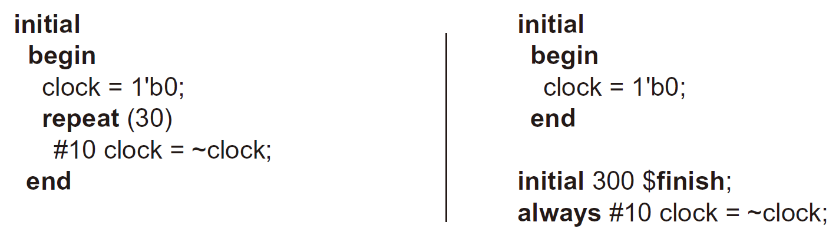
5-6 Synthesizable HDL Models of Sequential Circuits
Behavioral Modeling
Example: Two ways to provide free-running clock
Example: Another way to describe free-running clock
5-<number>

Slide 51
Conclusions
Verilog modeling
  structured modeling
  continuous assignment
  RTL modeling
Design digital systems
  separate combinational and sequential description
  always keep your target circuits in mind

